Slide 1
Sewer Advisory Panel Draft Presentation
Jackie Brown
Tom Chapman
Gabe del Rio
Albert Pollard Jr
Jeremey Taylor
Tides Inn representative:
Marston Smith
5/16/22 version

Slide 2
Interest in Central Sewer Service
Business:
The Tides Inn:
Wants to get out of operating wastewater treatment plants
Shutting down their treatment plants will likely allow the central branch of Carters Creek to be closed to shellfish harvesting seasonally versus the current year-round.
ICN/King Carter Holdings:
Considers central collection system important to development plans for business district
Considers central collection system important to development of Farm Road property
Vineyard Meadows:
Considers central collection system important to future development
Residential:
Due to lack of maintenance, poor soil conditions some homeowners have had to replace their existing systems over the years often with advanced systems. Some still have issues in periods of heavy rain.

Slide 3
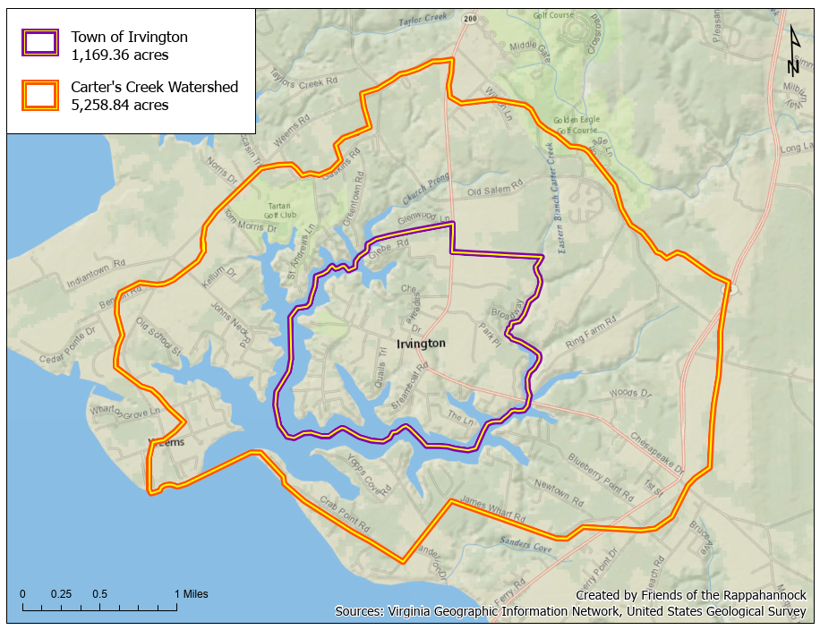
Carters Creek Watershed with Irvington’s Town Limits
Irvington: 23% of watershed.
Average Elevation:
Irvington: 30 feet
Norfolk: 7 feet
Deltaville: 10 feet
Mathews: 7 feet

Slide 4
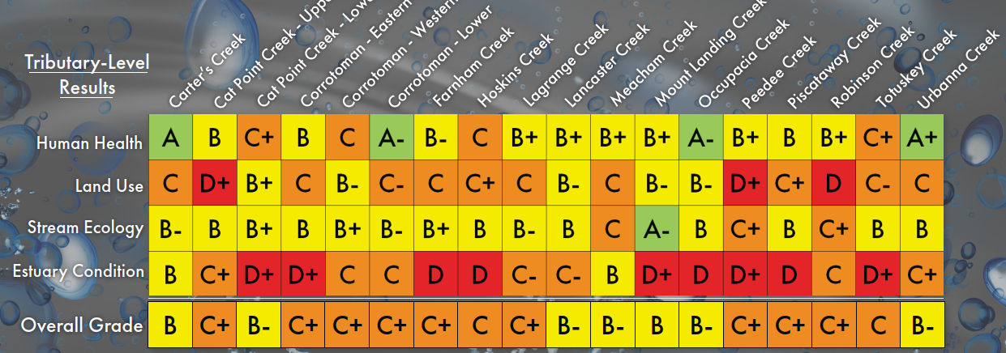
VDH guideline for Swimming is more than 200 CFU/100 ml
CFU is Colony forming units, the measure of Fecal Coliforms

Slide 5
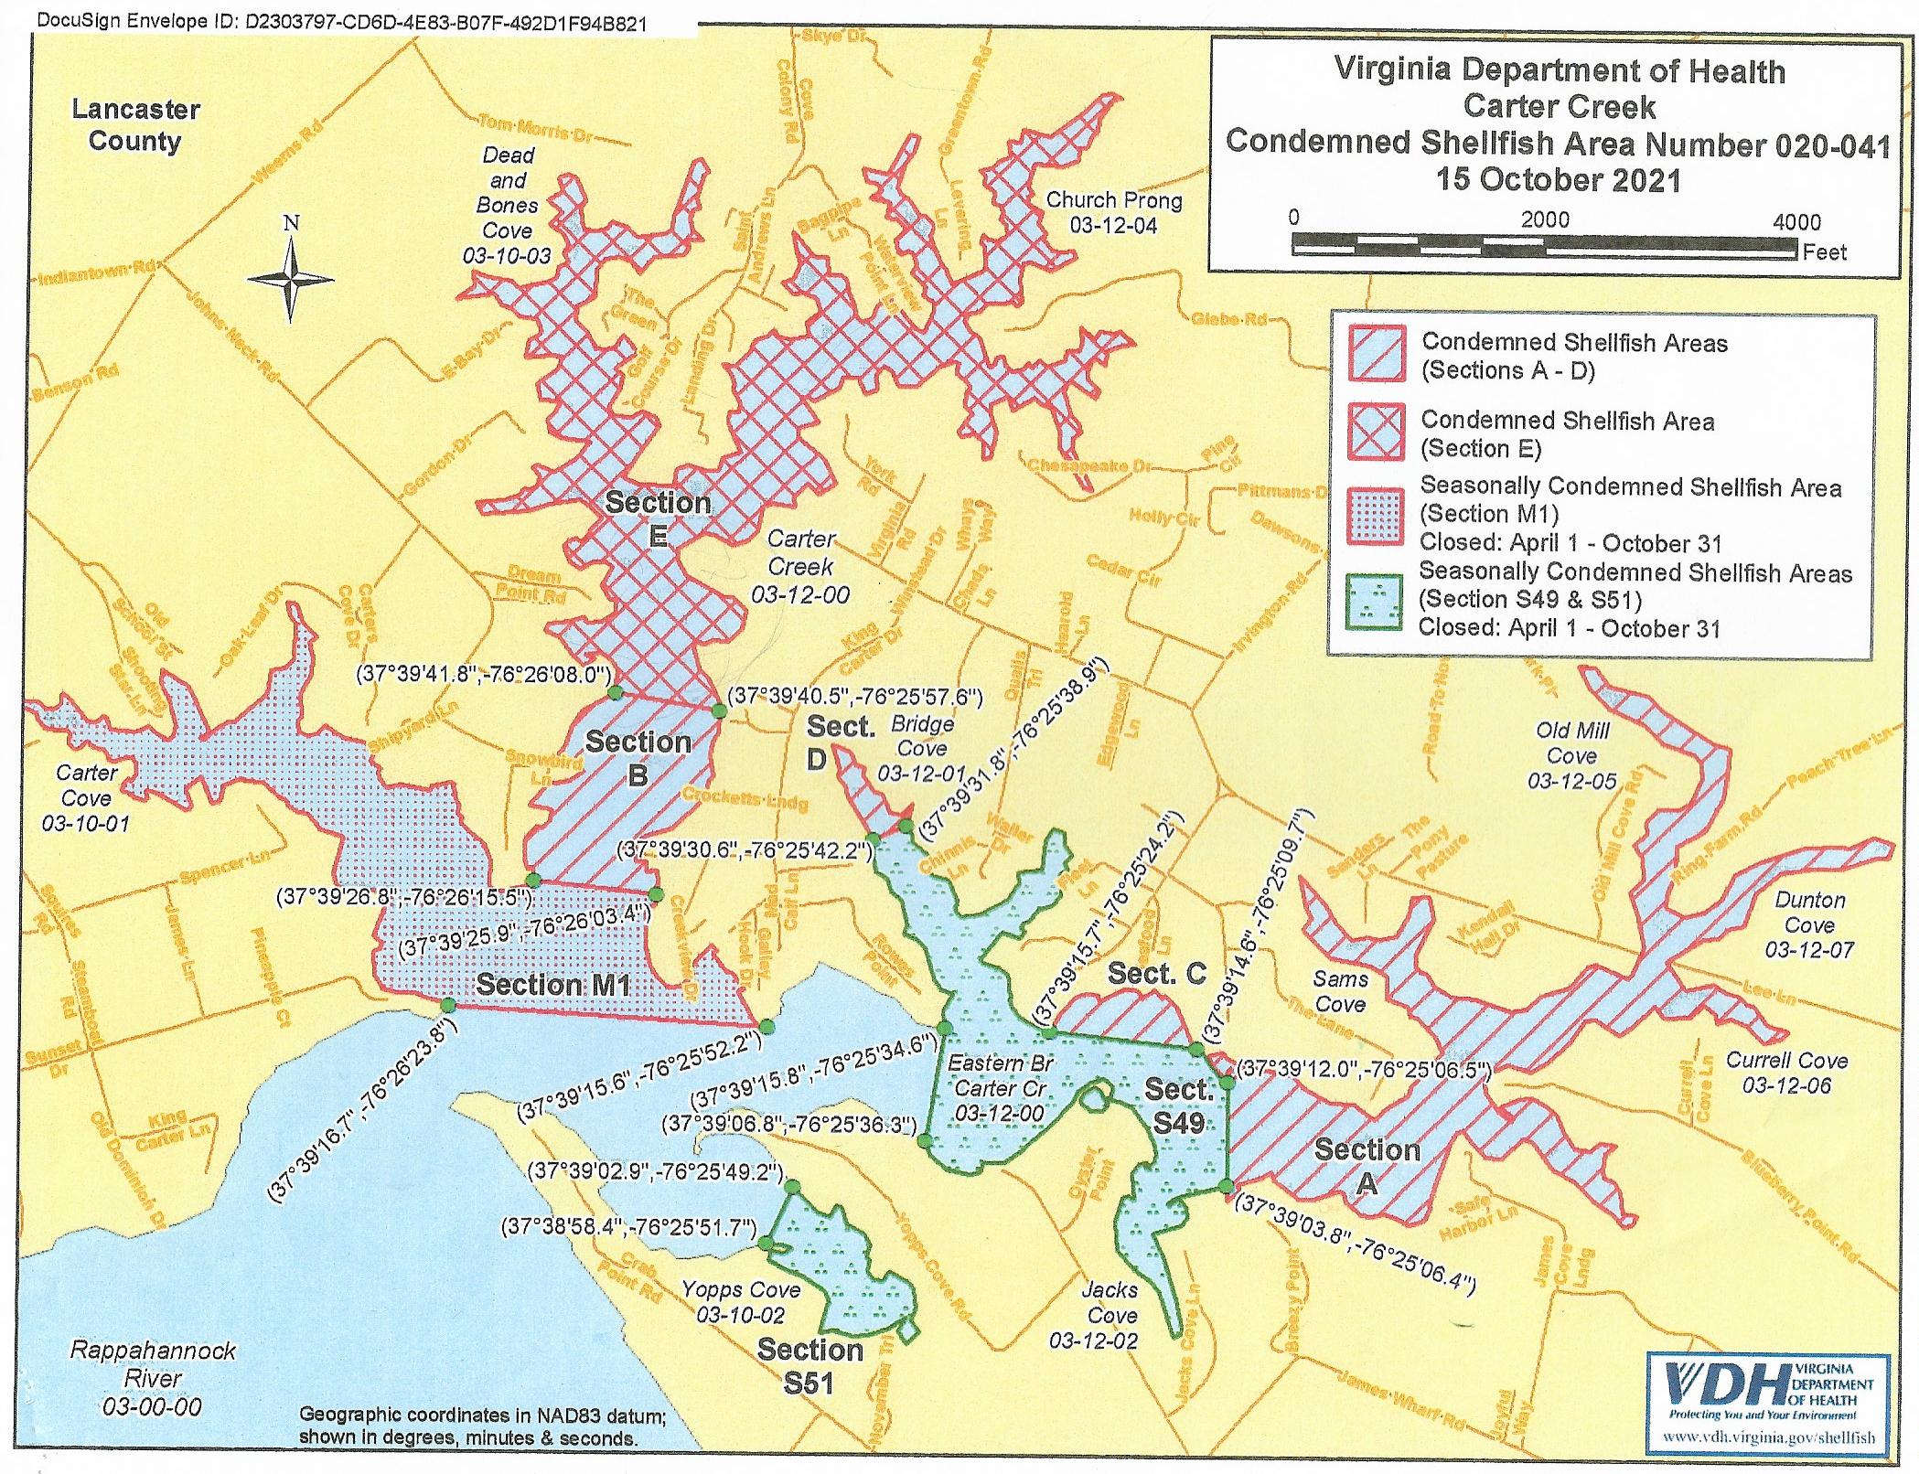
Carters Creek: VDH DSS Map
Tides Inn Plants Outlets
The further up the creek you go the less flushing of natural background contamination
Areas near marinas are always seasonally condemned
5.8/22.6
5.7/21
7.8/36
For year round shellfish harvesting 30 sample avg must be less than 14 CFU/100 ml
And 90% less than 31 CFU/100 ml

Slide 6
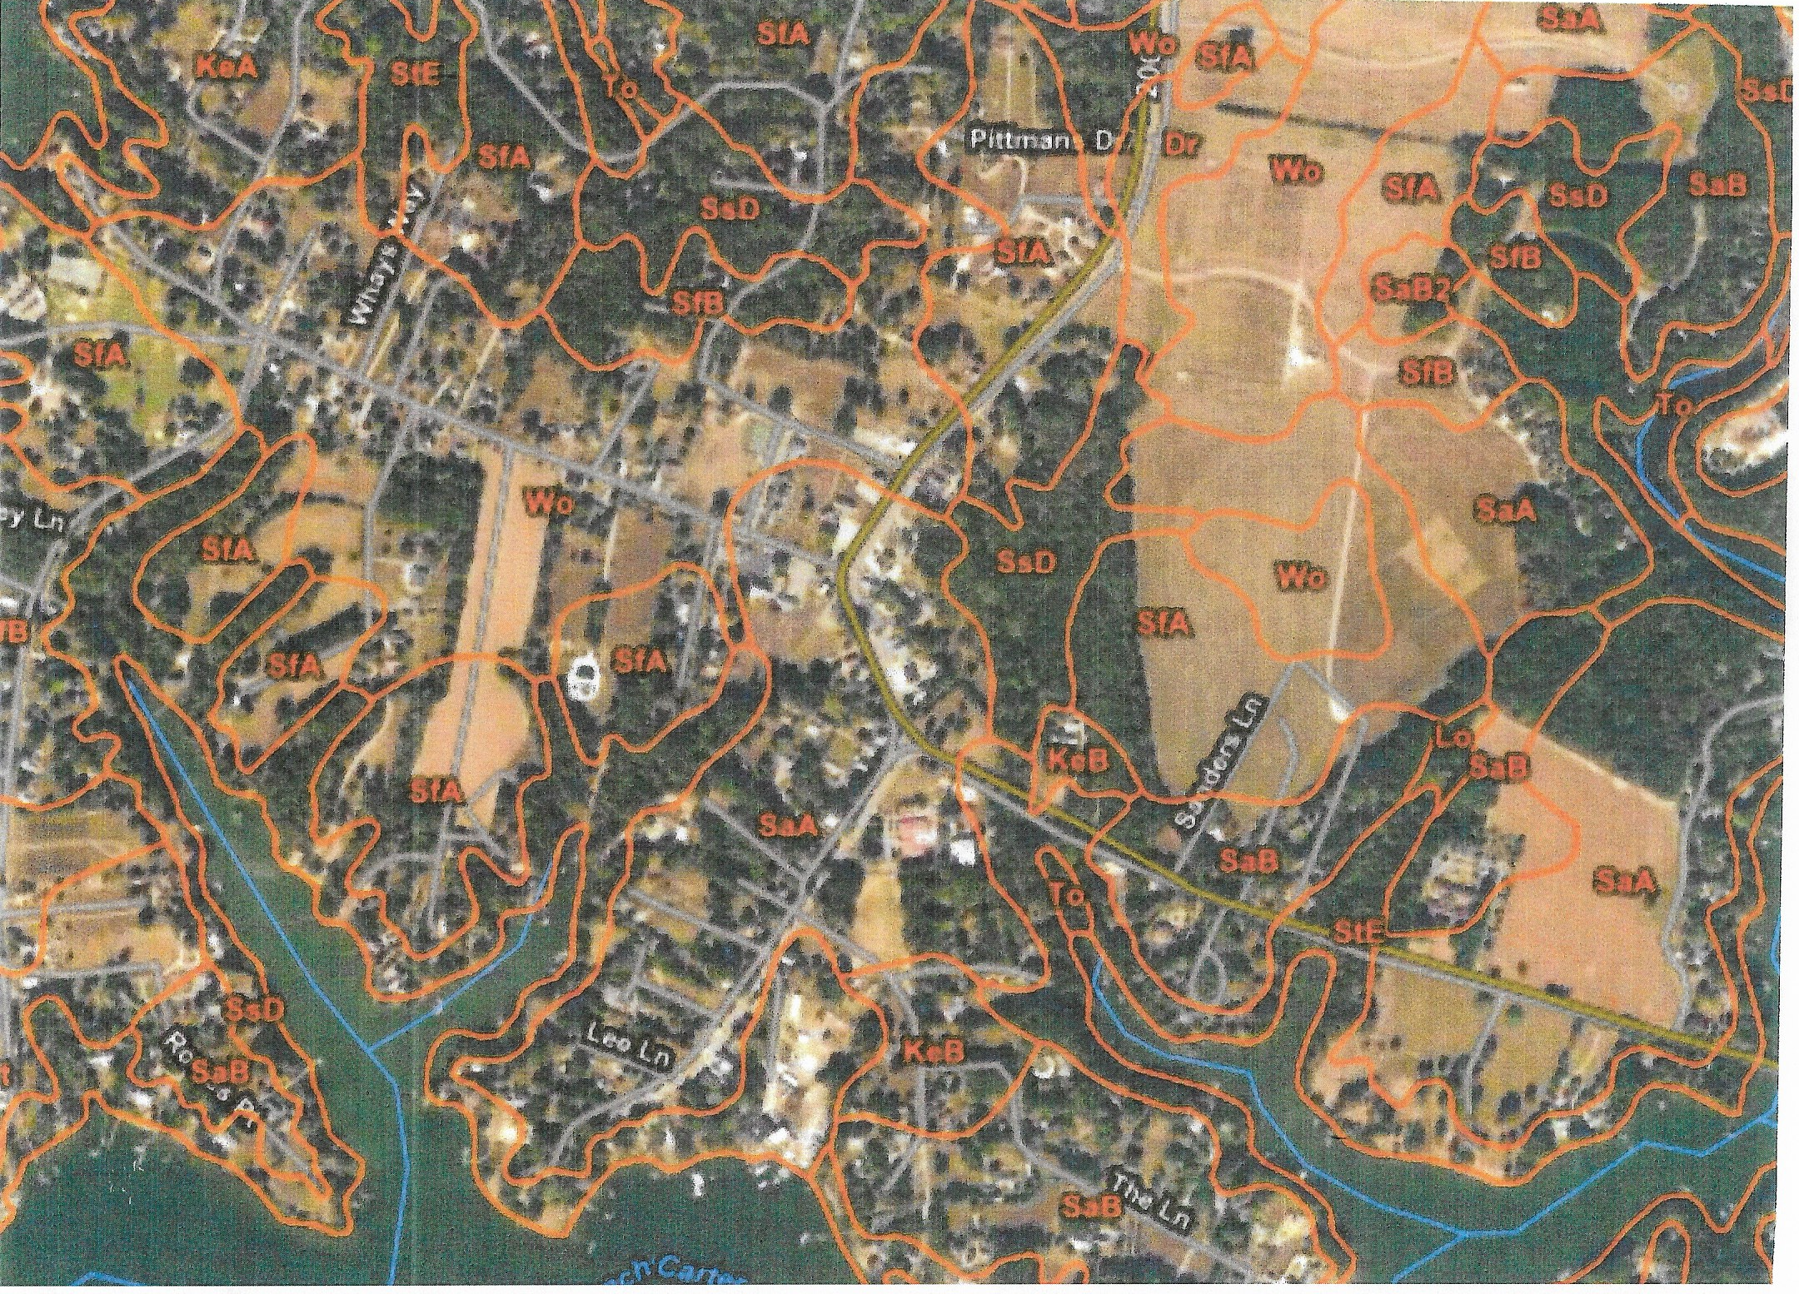
Irvington Soil Conditions
Sassafras: Depth to Water Table
48-72 inches
Well drained
Wo: Depth to Water Table
18-30 inches
Moderately well drained
Dr: Depth to Water Table
12—18 inches
Somewhat poorly drained
Certain areas of Irvington, especially along King Carter Drive and areas of Farm Road and
Vineyard Meadow have soil conditions where advanced septic systems are now required

Slide 7
Irvington Septic System History
Historically Conventional Septic Systems had been permitted in all of Irvington
In the last shoreline survey by VDH in 2016 only two systems were found deficient
In the five-year period from 1/17 to 2/22, 31 permits were issued, 10 for new houses, 21 repairs, many repairs were L-3 Systems as were some for new houses.
Septic System Effluent mg/l (BOD,TSS, TKN)
Conventional: 150,80,60
TL-3: <10, <10, 30 and disinfection
Properly designed and maintained Septic Systems do not contaminate Carters Creek with fecal coliforms (VDH, VIMS, EPA)

Slide 8
Alternatives and Best Guess Capital Costs:
A. Conventional and AOSS with clustered Decentralized Systems
EPA endorses these systems as long term treatment alternatives
Residents continue to operate and maintain their systems
New and replacement systems installed as needed
Conventional system replacement $8,000
Drain field replacement $4,500
AOOS replacement $30,000
B. Town Center collection system with treatment by Kilmarnock
1.4 mile low pressure force main down KC drive and out RT 200 to town limit with 1.8-mile pumping station to Kilmarnock connection
Assumes 20 resident connections and ICN/King Carter Holdings and Vineyard Meadows connections by them
Kilmarnock connection fee estimate $10,000 and home connection estimate $2,000
Best Guess Capital cost: $2.4 million, range $2.3 to $3.2 million
C. Complete Town collection system with treatment by Kilmarnock
Estimate 8 miles of low pressure force main through Town with 1.8 miles with pumping station to Kilmarnock connection
380 potential connections with assumed 266 actual connections
Kilmarnock connection fee $10,000 and home connection $2,000
Best Guess Capital cost: $7.5 million, range $7.2 to $9.8 million

Slide 9
Grant and Loan Capitalization of a Wastewater/Sewer Treatment for Irvington
Irvington will not likely qualify for much if any standard grant funding by the state of Virginia through the Community Development Block Grant (CDBG) program due to the income levels of Irvington residents and lack of blight.
A CDBG planning grant to study and build a long-term plan is applicable but given the ARPA funds on-hand with the Town of Irvington, this would not seem necessary. A complete professional engineering report and cost estimate can be completed with ARPA funds.
All grants require well-laid plans, leveraged investments, relationship development, and time to develop. While Irvington residents and businesses may not qualify for CDBG funding, there are many other federal and private sources of funding. This initial survey was not exhaustive in determining all sources.

Slide 10
Grant Capitalization for future phases of a Wastewater/Sewer Treatment Infrastructure Plan for Irvington
Irvington may qualify for other federal infrastructure grants within the latest funding, but applications have not yet opened. In order to qualify for any capital grant, Irvington must first:
Create and commit to a plan
May include Phases
Should be part of comprehensive plan (in which we should show progress and be specific)
Take steps to initiate as much as of the plan as is possible with existing revenue opportunities
Meals tax to fund phase 1 for Town Center
Seek additional funding for future phases from infrastructure grants not tied to low-income areas or blighted communities.

Slide 11
Loan Capitalization of a Wastewater/Sewer Treatment for Irvington
Revenue Assumptions for Sewer Capitalization
Estimate of meals tax basis (total annual sales): | $ 6,000,000
Standard Meals Tax | 2.5%
Meals Tax Revenue for Irvington | $ 150,000
Financing Capital Costs of Sewer (Option B)
Assumes 4% cost of funds on a 30-year term | $ 2,500,000
Annual Principal & Interest Payments | $ (143,220)
Annual Surplus/(Loss) from Meals Tax and Sewer | $ 6,780

Slide 12
Loan Capitalization of a Wastewater/Sewer Treatment for Irvington
Loan capitalization is available through both the EPA and USDA for rural wastewater treatment and sewer installations. Locally, USDA has been the leading partner in financing these facilities for municipalities.
Irvington can clearly finance the installation of a sewer line connected to Kilmarnock for the central (King Carter Drive and Irvington Road) portion of the town; covering both the Town Commons and Restaurant/Hotel Business district with a Meals Tax.

Slide 13
The best local resource for technical assistance with planning and grant applications is the Northern Neck Planning District Commission (NNPDC)
Northern Neck Planning District Commission (NNPDC)
457 Main Street P.O. Box 1600 Warsaw VA 22572
Voice (804) 333-1900
Fax (804) 333-5274
Staff:
Jerry W. Davis, AICP – Executive Director – jdavis@nnpdc17.state.va.us
John Bateman – Regional Planner – jbateman@nnpdc17.state.va.us
Ben Lewis – Assign a Highway Coordinator – blewis@nnpdc17.state.va.us
Lisa Hull – Economic Development Coordinator – lhull@nnpdc17.state.va.us

Slide 14
Recommended Next Steps
Discussion with Key Business Stakeholders Prior to Workshop – Complete
Town Council and Planning Commission Input at Workshop
RFP for Professional capital cost estimates with engineering – All alternatives including decentralized systems
Grant Committee continues search for funding
Survey Results

