Slide 1
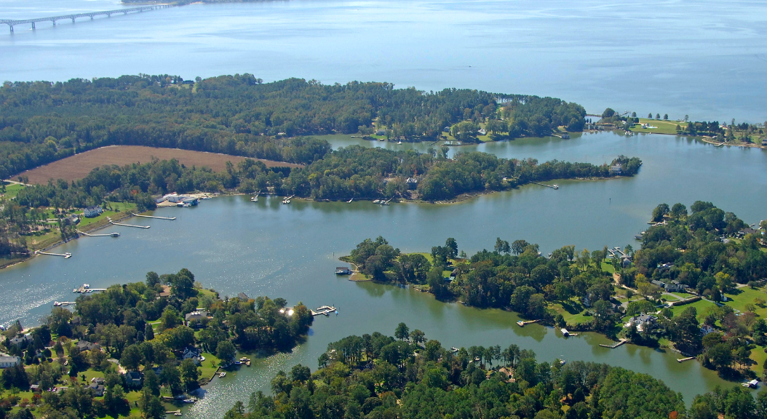


PER Findings Presentation
Town of Irvington Wastewater System
FEBRUARY 27, 2024

Slide 2
Agenda
Call To Order
Introduction
Bowman Presentation of Preliminary Engineering Report (PER)
Sewer Committee Presentation of Alternatives and Next Steps
Public Questions and Comments

Slide 3
Irvington Sewer Committee
Phil Robinson
Jeremy Taylor
Jackie Brown
Albert Pollard, JR
Tom Chapman

Slide 4
Sewer Committee Recommendations 5/22 updates in bold
A. Conventional and AOSS with clustered Decentralized Systems
EPA endorses these systems as long term treatment alternatives
Residents and Businesses continue to operate and maintain their systems
New and replacement systems installed as needed
Conventional system replacement $8,000
Drain field replacement $4,500
Engineered AOSS replacement $30,000
B. Town Center collection system with treatment by Kilmarnock
1.35 mile low pressure force main down KC drive and out RT 200 to town limit with 1.25-mile to Kilmarnock connection at Compass.
Assumes 22 resident, 10 light business connections, Tides, and ICN/King Carter Holdings and Vineyard Meadows.
Kilmarnock connection fee estimate $10,000 and home connection estimate $2,000 ????
Best Guess Capital cost: $3.5 million ($2.4 million, range $2.3 to $3.2 million)
C. Complete Town collection system with treatment by Kilmarnock
Estimate 8 miles of low pressure force main through Town with 1.25 miles to Kilmarnock connection at Compass.
165 Connections (380 potential connections with assumed 266 actual connections)
Kilmarnock connection fee $5000 - $10,000 ($10,000 and home connection $2,000)
Best Guess Capital cost: $7.9 million, 40% of residents ($7.5 million, range $7.2 to $9.8 million (70% of residents connect)

Slide 5
Interest in Central Sewer Service
Business:
The Tides Inn:
Wants to get out of operating wastewater treatment plants
Shutting down their treatment plants will likely allow the central branch of Carters Creek to be closed to shellfish harvesting seasonally versus the current year-round.
ICN/King Carter Holdings:
Considers central collection system important to development plans for business district
Considers central collection system important to development of Farm Road property
Vineyard Meadows:
Considers central collection system important to future development
Residential:
Due to lack of maintenance, poor soil conditions a number of homeowners have had to replace their existing systems over the years sometimes with advanced systems. A number still have issues in periods of heavy rain. 40% of residents in Survey expressed interest in connecting if cost was $12,000.

Slide 6

Preliminary Engineering Review Agenda
Brief Overview of Project
PER Findings and Observations
Proposed Alternative
Associated Costs

Slide 7
Project Overview
The Town Council and Town’s Sewer Committee has commissioned Bowman to develop a Preliminary Engineering Report (PER) for submittal to USDA regarding the proposed upgrades for the existing wastewater system.
The PER details three alternatives and costs for wastewater collection and three alternatives and costs for wastewater treatment.

Slide 8
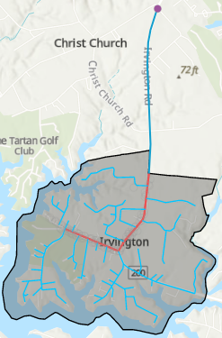
PER Treatment Alternatives - Refresher
Construct WWTP – Surface Water Discharge
  Highest Capital Cost: Purchasing Land with access to Carter’s Creek
  Town responsible for operation and maintenance
Construct WWTP – AOSS with Drainfields (White Stone)
  High Capital Cost: Purchasing Land with enough space and quality soil for Drainfields
  Town responsible for operation and maintenance
Existing Town of Kilmarnock WWTP
  Requires a more robust collection system, otherwise no construction cost
  Town responsible for paying connection fees to Town of Kilmarnock
  Recommended Option

Slide 9
Selected Alternative – Connection to Kilmarnock System
Kilmarnock’s Existing Sewer Infrastructure
  Collection System Extends into Lancaster County
  Conventional Gravity Sewer and Pumping Stations Generally Used
  Wastewater Treatment Facility
    There is available capacity within their wastewater plant
Lowest Cost Alternative
  Connection to existing Treatment infrastructure in Kilmarnock
  Low/Negligible Operation and Maintenance Costs
  No discharge permitting for Surface Water Discharge
  No Land Acquisition required for AOSS Systems

Slide 10
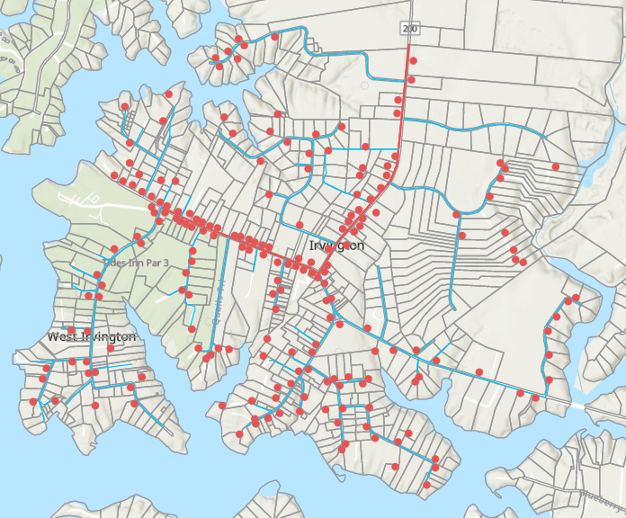
PER Conveyance Alternatives - Refresher
Low Pressure Sewer (White Stone)
  Network of Individual Grinder Stations – 1 installed at each system connection
  No Centralized Pumping Station(s) required
  Recommended Option
Vacuum Sewer and Vacuum Station
  Network of Vacuum Stations – 1 installed every 2 system connections
  Centralized Vacuum Pump Station(s) required
Conventional Gravity Sewer and Pumping Station
  Network of Manholes and Gravity Sewer – Deeper excavations required
  Centralized Pump Station(s) required

Slide 11
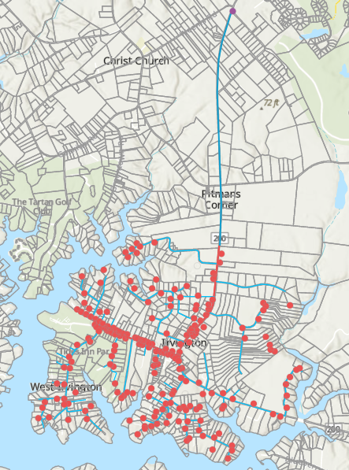
Selected Alternative – Low Pressure Sewer System
Low Pressure Sewer System shall send wastewater to existing wastewater treatment plant in Town of Kilmarnock.
System will run from Tides Inn to Compass Entertainment along “Town Center Line”
Collection System Connections based on 40% connection rate from Town Survey
Project will have phased approach: Phase 1 will build connections along “Town Center Line” and main line to Compass; Phase 2 will build remaining connections.

Slide 12
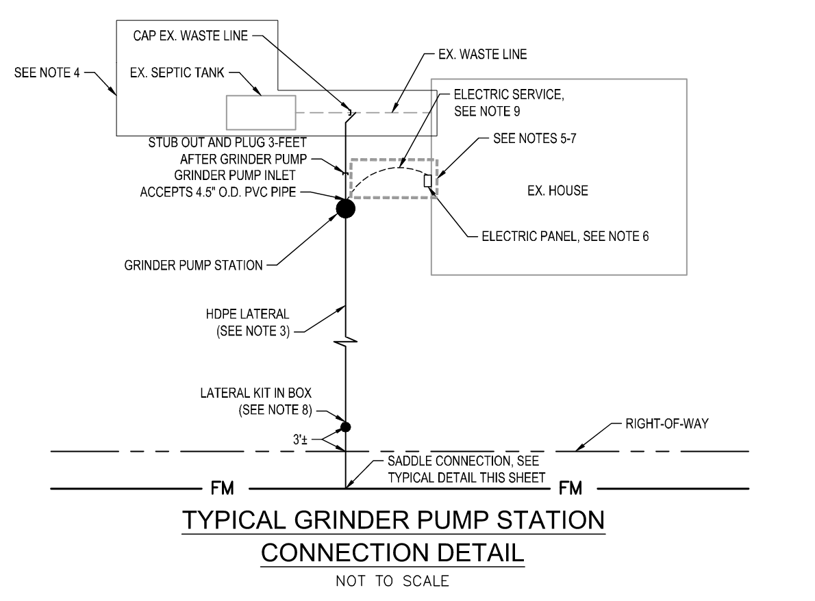
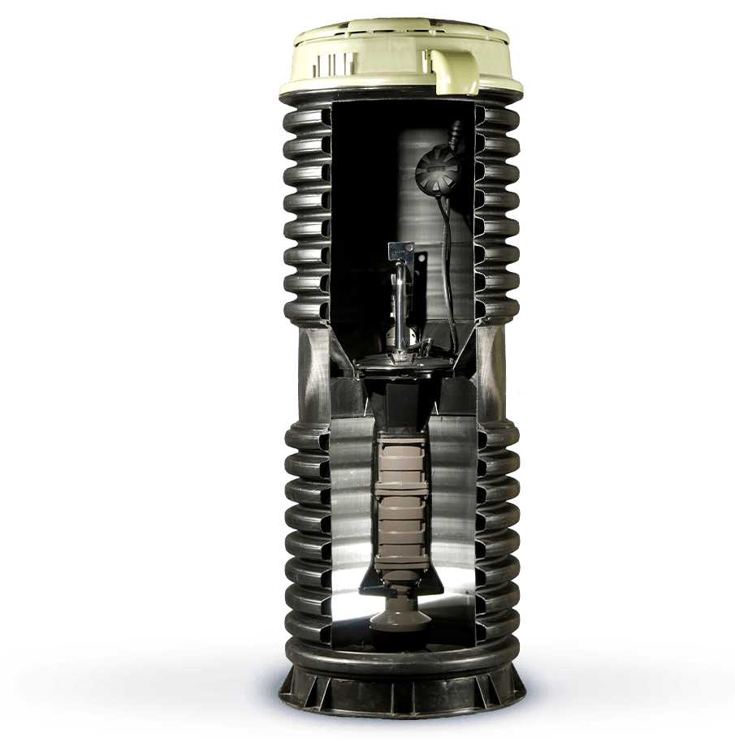
Low Pressure Sewer Alternative
Individual Grinder Stations
  ~11 gpm flow rates
  Single Phase Electrical Connections
    Powered from Home Supply
Easy to Phase throughout Town
Multiple options for Flow Requirements
Lowest Cost and Most Effective Solution
  Low Property Impact
  Economy of Scale

Slide 13
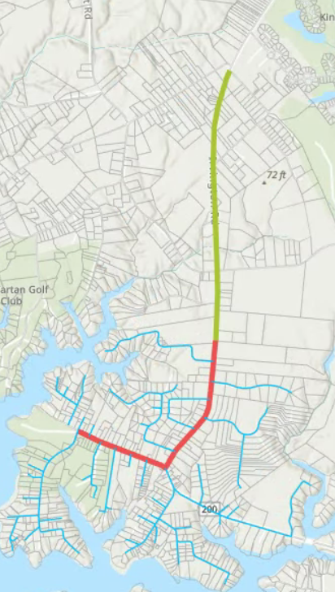
Associated Costs – Proposed Alternative Selected
Selected alternatives require costs for conveyance to Kilmarnock and connection fees to the Kilmarnock System.
No additional cost for land, treatment or other costs anticipated in alternatives selected.
Total Phase 1 – Town Center Sewer Conveyance
  Project Cost: $3,482,897
  Includes infrastructure from Town Limits to Kilmarnock
Total Phase 2 – Town Wide Sewer Conveyance
  Project Cost: $4,389,858
  Includes individual connections and pipe network throughout Irvington

Slide 14
Total Phase 1 – Town Center Sewer Conveyance Cost Breakdown

Slide 15
Total Phase 2 – Town Wide Sewer Conveyance

Slide 16
Alternative A Cost Estimates
Clustered AOSS for Farm Road and ICN Downtown Development* | $300,000
Clustered AOSS for Vineyard Meadows* | $900,000
Tides Inn Creek Crossing to Weems* | $1,000,000
Resident New Homes and Repairs | $6,000 to $30,000
Preliminary estimates by Bowman, various assumptions *

Slide 17
Town Center Line – Minimizing Cost to Town
Town Center Sewer Line | $3,493,000
Removal of Out-of-Town Portion | $760,000
Net Cost | $2,733,000
Removal of Laterals and Grinders | $750,000
Net Cost | $1,983,000
Potential Private Capital Contributions* | $600,000
Net Cost | $1,400,000

Slide 18
Resident Connection Cost
Lateral Piping | $5,000
Grinder | $8,500
Power and Piping to Grinder | $1,500
Kilmarnock Connection Fee* | $5,000
Total | $20,000
*Kilmarnock out of town connection fee is currently $15,000

Slide 19
Next Steps
USDA Review | 2/26/24 to 6/1/24*
TC-PC Workshop | 3/12/24
Investigate Funding Alternatives * | 3/15/24 to 7/1/224
Lancaster County Collaboration* | 4/1/24 to 7/1/24
Kilmarnock Collaboration* | 4/1/24 to 7/1/24
Public Private Collaboration* | 3/15/24 to 7/1/24
Identify Residents and Business Connections | 5/1/24-7/1/224
* All end dates are estimates

Slide 20

Public Comments
and Questions

