Slide 1


2023
Northern Neck Region Hazard Mitigation Plan Update
Public Comment Meeting
July 29, 2022

Slide 2
Today’s Agenda
Introductions
Steering Committee & Working Group
Hazard Mitigation Planning Overview
Work Plan / General Schedule
Data & Information Needs
Next Steps
Project Administration
Next Meeting / Action Items

Slide 3
Steering Committee
Name | Organization
Jerry W. Davis, AICP, Executive Director | Northern Neck Planning District Commission
John Bateman, Regional Planner | Northern Neck Planning District Commission
Alex Equiguren, Project Manager | Northern Neck Planning District Commission
TJ Rippon, Associate, Lead Project Hazard Mitigation Planner | The Olson Group, Ltd.
Peter Dennen, Senior Associate, Hazard Mitigation Subject Matter Expert | The Olson Group, Ltd.
Anthony Mangeri, Asst. Vice President for Mitigation and Resilience, Project Manager | The Olson Group, Ltd.
Scott Sleeman, Associate, Hazard Mitigation Planner | The Olson Group, Ltd.

Slide 4
Working Group Committee(1/2)
Names | Organization
Luttrell Tadlock, County Administrator | Northumberland County
Wes Packett, Director of Emergency Services | Northumberland County
Phillip Marston, Zoning Administrator | Northumberland County
R. Morgan Quicke, County Administrator | Richmond County
Mitch Paulette, Chief, Department of Emergency Services | Richmond County
Hope Mothershead, Code Compliance Officer | Richmond County
Joseph Quesenberry, Town Manager | Town of Warsaw
Melissa Coates, Director of Planning and Community Development | Town of Warsaw
Norm Risavi, County Administrator | Westmoreland County
Bill Cease, Director of Emergency Management and Technology | Westmoreland County
Beth McDowell, Director of Planning and Community Development | Westmoreland County
Darrin Lee, Assistant Planning Director | Westmoreland County
Matt Smith, Chief of Emergency Services | Lancaster County
Bill Farrell, Director of Planning and Land Use | Lancaster County

Slide 5
Working Group Committee(2/2)
Names | Organization
Marshall Sebra, Planning-Zoning Director | Town of Kilmarnock
Susan Cockrell, Town Manager | Town of Kilmarnock
Julie Harris, Mayor | Town of Irvington
Laurel Taylor, Town Clerk | Town of Irvington
Patrick Frere, Town Manager | Town of White Stone
Melinda George, Town Clerk | Town of White Stone
India Adams-Jacobs, Town Manager | Town of Colonial Beach
Patricia Lewis, Town Manager | Town of Montross
Matt Dalon, Program Manager, Virginia Coastal Resilience Master Plan | Department of Conservation and Recreation
Mark Killgore, Lead Dam Safety Engineer | Department of Conservation and Recreation
Wendy Howard-Cooper, Director Dam Safety and Floodplain Management | Department of Conservation and Recreation
Angela Davis, Floodplain Program Planner | Department of Conservation and Recreation
Chris Bruce, All Hazards Planner | VDEM, Region 5
Mary Lee, Community Planning Lead | FEMA, Region 3

Slide 6
HMP PURPOSE
Today’s workshop will provide stakeholders with:
  an overview of hazard mitigation planning in the Northern Neck PDC.
  a synopsis of the planning project, planning components, and processes.
  an understanding of their roles and responsibilities

Slide 7
HMP Benefits
  More resilient community.
  Reduced risk (Insurance Cost).
  Supports participation in NFIP-CRS Program
  Support RAFT Efforts to promote community resiliency
  Required for hazard mitigation assistance programs.
  Required for post-disaster FEMA Public Assistance and Hazard Mitigation Grant programs.

Slide 8
Jurisdictional Participation Requirements
Attendance at regularly scheduled jurisdiction coordination meetings to include all Working Group meetings
A commitment to read plan materials and to participate in the joint planning process.
A commitment to complete tasks and requests in a timely manner.
Adopt HMP once approved by VDEM and FEMA

Slide 9

Risk Matrix and Hazards

Slide 10
Northern Neck Planning District Commission
Regional Hazard Mitigation Plan Overview

Slide 11
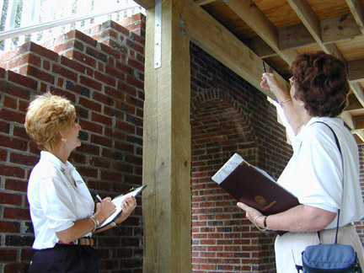
Potential Mitigation Projects
“Soft” Mitigation Projects:
Building code
enforcement.
Land development
regulations.
Public education.
Studies and plans.
More…

Slide 12
Potential Mitigation Projects
“Hard” Mitigation Projects or “Property Protection” Construction:
Elevation, mitigation, and reconstruction of structures.
Retrofits for high wind loads such as installing hurricane shutters.
Storm Water Management Improvements.
Utility improvements.
Physical Security Enhancements (equipment)
More…

Slide 13
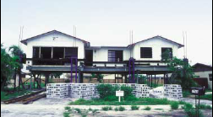
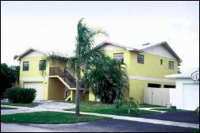
Elevation
Raising a structure above the Base Flood Elevation.
Consideration must be given to building size, structural integrity, and type of foundation.
There are different types of elevation which can be used depending on the structure.
  Top Picture: A house in Miami in the process of being elevated.
Bottom Picture: That same house once completed.
Taken from FEMA, Above the Flood, 2000

Slide 14
Mitigation Reconstruction
Pilot program funded under Disaster Declarations 1603 and 1607 (Hurricanes Katrina and Rita).
If elevation is not feasible then accept risk or reconstruct at the same location and meet current construction codes and standards.

Slide 15
Hardening or Retrofitting of Critical Facilities
Potential Projects for county buildings (hospitals, health care facilities, utilities, police stations, emergency operations center, housing, physical plant, etc.):
Install shutters or impact resistant glass on windows.
Strengthen the doors.
Install hurricane straps and clips to strengthen roof.
Bolt walls to foundation.
Relocate utility lines underground.
Elevate the heating, ventilating and cooling (HVAC) equipment, such as furnace and hot water heater.

Slide 16
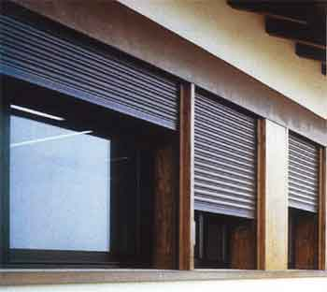
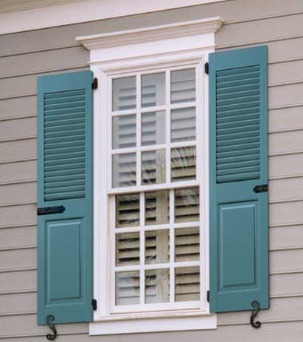
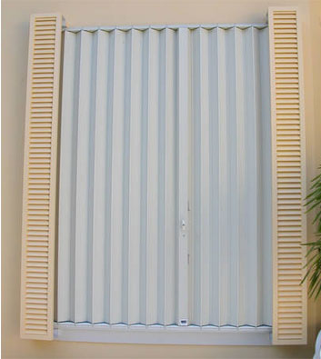

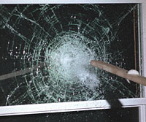
Hardening or Retrofitting of Critical Facilities
Install Shutters or Impact Resistant Glass on Windows
Roll-Down Shutters
Colonial Shutters
Accordion Shutters
Impact-Resistant Glass
Corrugated Metal Panel

Slide 17
Hardening or Retrofitting of Critical Facilities
Strengthen the Doors
*Source: Against the Wind

Slide 18
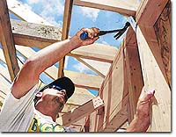
Hardening or Retrofitting of Critical Facilities
Install Hurricane Straps and Clips
to Strengthen the Roof
*Source: Against the Wind
*Source: Against the Wind
*Source: The Advocate

Slide 19
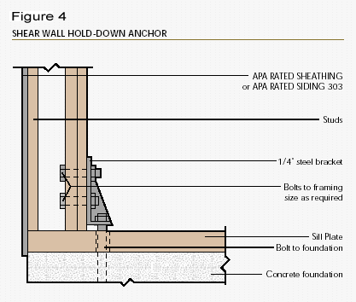
Hardening or Retrofitting of Critical Facilities
Bolt Walls to the Foundation
Source www.townparkconstruction.com

Slide 20
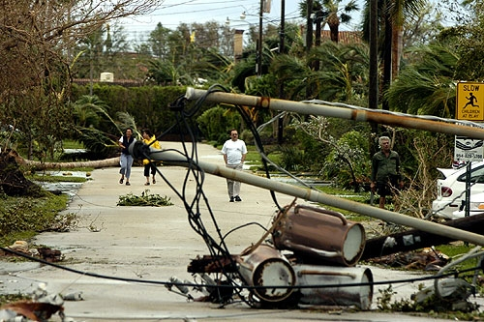
Hardening or Retrofitting of Critical Facilities
Relocate Utility Lines Underground
*Fallen utility lines after Hurricane Wilma. Source: www.galtmile.com

Slide 21
Hardening or Retrofitting of Critical Facilities
Elevate The Heating, Ventilating and Cooling (HVAC) Equipment, Such as Furnace and Hot Water Heater.
*Source: FEMA, Protecting Building Utilities

Slide 22
Hardening or Retrofitting of Critical Facilities
Potential projects for pump stations, water control facilities, water treatment and delivery systems, power generation and treatment facilities:
  Install backflow valves.
  Elevate the generators and pumps.
  Anchor fuel tanks.
  Eliminate infiltration problems with underground utility systems.

Slide 23
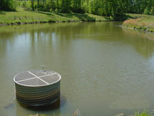
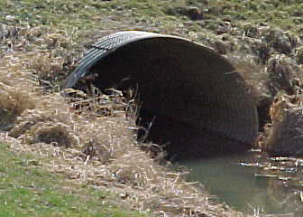
Drainage Improvements
Creating detention/retention ponds and reservoirs.
Building floodwalls and diversions.
Constructing storm sewers and increasing culvert capacity.
Maintenance is not an eligible project.
Retention Pond in North Carolina
Culvert

Slide 24
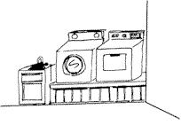
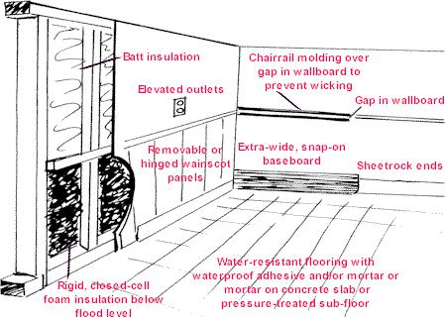
Wet Flood Proofing
Modifying uninhabited portions of the structure to allow floodwaters to enter without causing significant damage.
Materials must be water resistant.
Not practical for most slab-on-grade structures with living space near ground level.
*Source: Elevated Appliances from www.louisianafloods.org
*Source: www.louisianafloods.org

Slide 25
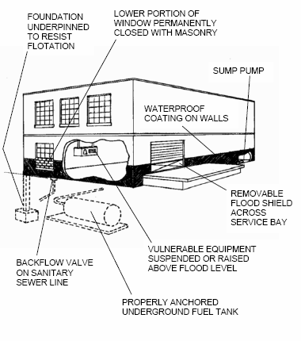
Dry Flood Proofing
Making the structure watertight below the level that needs flood protection.
Requires sealing the walls and providing waterproof closures for any openings such as doors.
*Source: FEMA, Protecting Your Business from Flooding

Slide 26
Dry Flood Proofing
Effective for low duration flooding with depths under 3 feet.
Not effective for high velocity flooding.
*Source: FEMA, Protecting Your Business from Flooding

Slide 27
Community Shelters?
A structure built to withstand extreme winds and flying debris from tornadoes, hurricanes, and other storms that is accessible to the public.
Guidelines can be found in FEMA 361.
The shelter cannot be used for anything else.

Slide 28
Shelter in Place Areas
Must be securely anchored to the foundation and structurally isolated from the main structure.
Can be on the first floor, in a basement, or outside.
Guidelines are outlined in FEMA Publication 320.

Slide 29
Hazard Mitigation
Evacuation Route Awareness
Warning and alert systems
Event actions

Slide 30
NEXT STEPS

Slide 31
Next Steps
Data Acquisition
  Jurisdictional Interviews (Assessments and Projects)
  Review of Current HAZUS.
  Hazard Identification Review & Profiling.
  Capability Assessment Survey.
  Schedule Steering & Work Group Committee Meeting _______________

Slide 32
General Schedule

Slide 34
Time-Line
Task | # of Weeks/Month | Details
Project Management | Continuous throughout project | Monthly status reports to the Northern Neck PDC Project Officer Frequent communication and prompt reply to email and phone calls
Task 1 – Conduct Project Kickoff Meeting | Scheduled for July 15, 2022 @ 1000 | Review scope of project Identify Steering Committee and Working Group Members Refine project schedule Identify data needs/sources Schedule Stakeholder/Public Meeting(s)
Task 2 – Review Documents | Weeks 1 – 3 Completed by July 29, 2022 | Review existing HMP Review floodplain and other pertinent ordinances Review other documents (e.g. land use, zoning, etc.)
Task 3 – Conduct Stakeholder Introductory Meeting | Week 2 Scheduled for July 29, 2022 | Introduce the project to public and private stakeholders Provides first opportunity for municipal participation Sets the stage for the planning effort

Slide 35
Time-Line
Task | # of Weeks/Month | Details
Task 4 – Identify and Review Hazard and Losses | Weeks 3 – 5 Provisional completion by August 12, 2022 Working Group & Public Comments Meeting #2 – Scheduled for August 12, 2022 | Review hazards Identify additional threats Profile hazards Inventory assets Estimate losses
Task 5 – Review and Edit Mitigation Actions and Implementation Strategies | Weeks 6 – 8 Provisional Completion by September 2, 2022 Working Group & Public Comments Meeting #2 – Scheduled for September 9, 2022 | Review Goals and Objectives Review Capability Assessment Review/Revise Existing Actions Review/Revise Implementation Strategies
Task 6 – First Draft | Completed by September 30, 2022 Steering Committee/Working Group Meeting – TBA – by September 30, 2022 Public Comment Period September 25 – October 8, 2022 | First draft completion Public Comment Period

Slide 36
Upcoming Meetings
Event | Date | Time | Location
Working Group & Public Comment Meeting #1 | Friday, August 12, 2022 | 1000 hours (10:00 a.m.) | Virtual via Microsoft TEAMS
Working Group & Public Comment Meeting #2 | Friday, September 9, 2022 | 1000 hours (10:00 a.m.) | Virtual via Microsoft TEAMS
Steering Committee and Working Group Meeting | TBD | TBD | Virtual via Microsoft TEAMS
Working Group & Public Comment Meeting #3 | Friday, October 7, 2022 | 1000 hours (10:00 a.m.) | Virtual via Microsoft TEAMS

Slide 37
Questions and Comments

Slide 38
Contacts
TJ Rippon, Lead Project Hazard Mitigation Planner
  trippon@olsongroupltd.com
  757-710-5772
Peter Dennen, Hazard Mitigation Subject Matter Expert
  pdenned@olsongroupltd.com
  609-922-5593
Anthony S. Mangeri, Project Lead, Asst. V.P. of Hazard and Resiliency
  amangeri@olsongroupltd.com
  (856) 217-9172
Scott Sleeman, Hazard Mitigation Planner
  ssleeman@olsongroupltd.com
  (512) 534-1878

