Slide 1
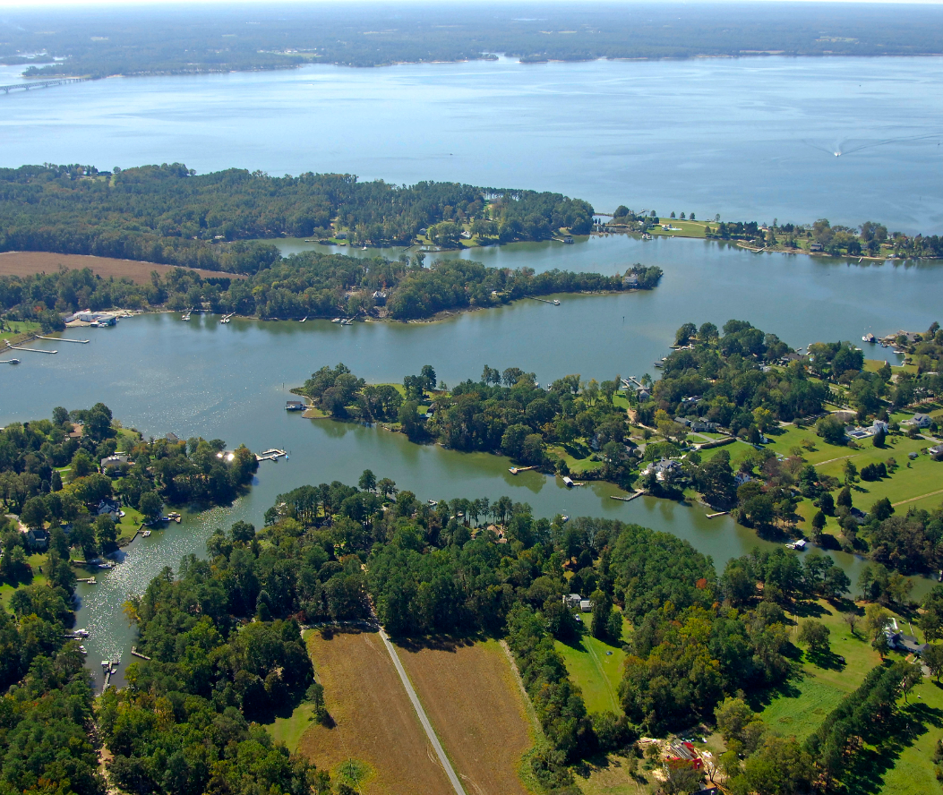
Town of Irvington Stakeholder Meeting Results & Discussion
Prepared by EPR, P.C. for the Town of Irvington
March 23, 2023

Slide 2
Public Sewer System

Slide 3
Town Efforts To-Date: Sewer Advisory Panel, March 2022
Potential Scenarios:
A. Conventional and Alternative Onsite Sewer Systems with clustered Decentralized Systems
EPA endorses these systems as long-term treatment alternatives
Residents continue to operate and maintain their systems
New and replacement systems installed as needed
Conventional system replacement $8,000
Drain field replacement: $4,500
AOSS replacement: $30,000
B. Town Center collection system with treatment by Kilmarnock
1.4-mile low pressure force main down KC drive and out RT 200 to town limit with 1.8-mile pumping station to Kilmarnock connection
Assumes 20 resident connections and ICN/King Carter Holdings and Vineyard Meadows connections by them
Kilmarnock connection fee estimate $10,000 and home connection estimate $2,000
Best Guess Capital cost: $2.4 million, range $2.3 to $3.2 million
C. Complete Town collection system with treatment by Kilmarnock
Estimate 8 miles of low-pressure force main through Town with 1.8 miles with pumping station to Kilmarnock connection
380 potential connections with assumed 266 actual connections
Kilmarnock connection fee $10,000 and home connection $2,000
Best Guess Capital cost: $7.5 million, range $7.2 to $9.8 million
Notes:
Council has authorized a feasibility study – also refer people to the presentation (on the town website)

Slide 4
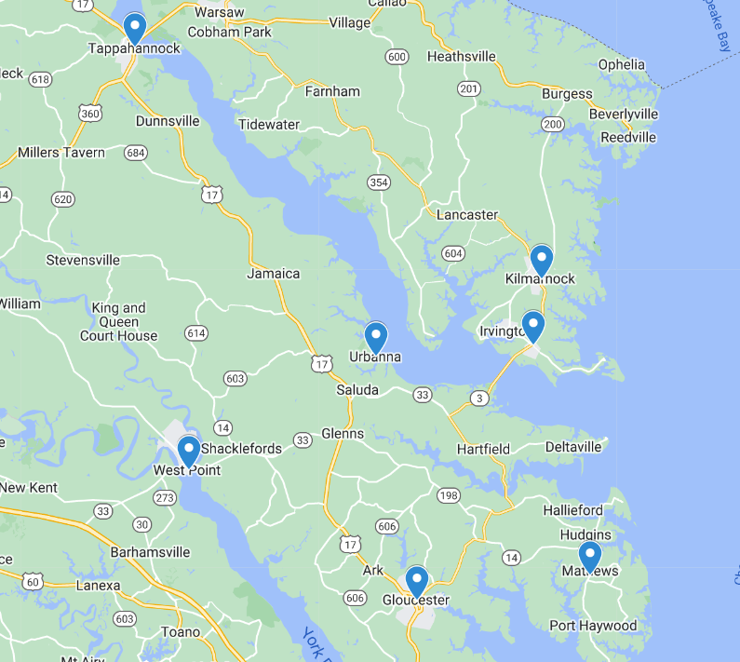
Existing Municipal Sewer Systems in the Region

Slide 5
2022 Community Survey Results Opinions on Sewer Services (check all that apply)
50%
Note: Percentages of total responses. Respondents could select multiple options
Notes:
On “Opinions on Sewer Services”:
7 people selected both “I have experienced difficulties with my septic system that required repair…” and “The Town does not need to invest in a public sewer at this time”
1 person selected both “Wet or rainy weather sometimes causes issues with my septic system” and “The Town does not need to invest in a public sewer at this time”
No one selected “I have experienced difficulties…”, “Wet or rainy weather…”, and “The Town does not need to invest…”

Slide 6
Public Sewer: 2023 Stakeholder Meeting Responses
Support | Conditionally Support | Neutral | Conditionally Oppose | Oppose
8 | 6 | 9 | 4 | 2
A need for more information about cost, feasibility, etc. before forming an opinion
Support for a limited option that serves King Carter Dr. and the Tides Inn
Support for a sewer system that serves the entire town, but where connection would be voluntary
Concern that a sewer system would attract unwanted growth
Some opposition to a sewer system in general

Slide 7
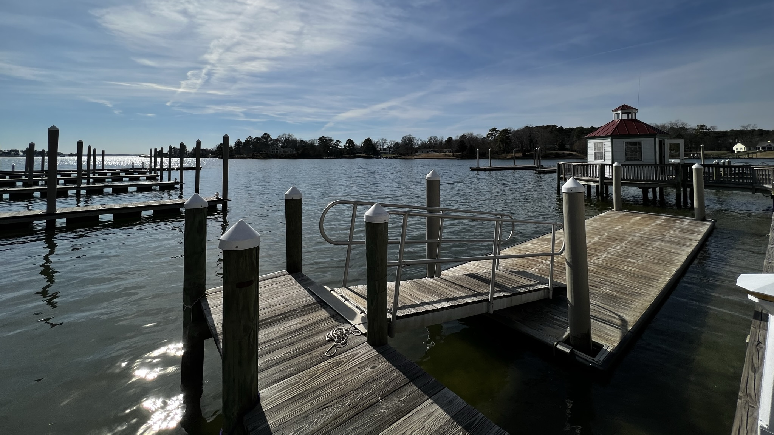
Waterfront Public Access

Slide 8
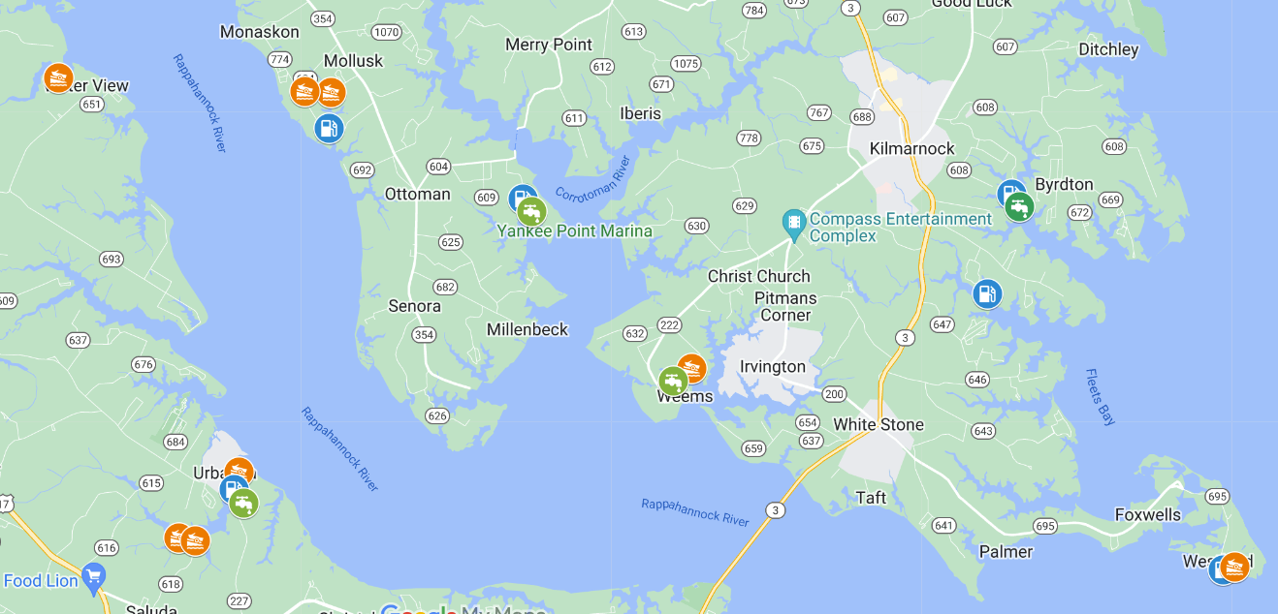
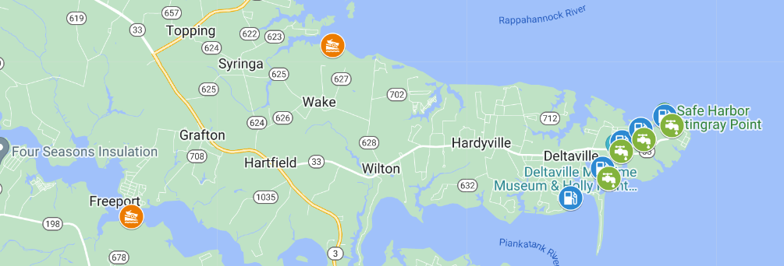
Existing Waterfront Access in the Region

Slide 9
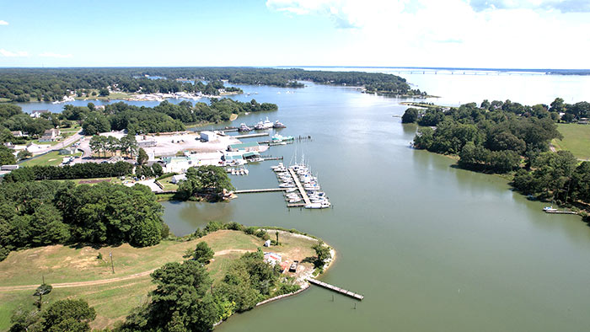
Planned Waterfront Access in the Region
Lancaster County has been awarded a $150,000 planning grant from the Virginia Outdoors Foundation to help develop the new Carter Cove County Park in Weems. The grant, pursued by a citizen board appointed to help with public access, is a major step in the goal of getting better public access to the waters surrounding Lancaster County. The five-acre parcel for the new park was acquired by the county earlier this year. Proposed amenities include:
A kayak/canoe launch,
Fishing pier,
Picnic shelter, and
A boat ramp with courtesy dock.
4.5 miles (8 minutes) from Irvington

Slide 10
Existing Private Waterfront Access in Irvington
Note: this is an estimate based on analysis of aerial imagery.

Slide 11
2022 Community Survey Results Opinions on the waterfront and public water access (check all that apply)
50%
Note: Percentages of total responses. Respondents could select multiple options
Notes:
112 people selected both “I would like for the Town to acquire waterfront property for boat/kayak access” and “I would like for the Town to acquire waterfront property for a park or gathering space”

Slide 12
Waterfront Access: 2023 Stakeholder Meeting Responses
Support | Conditionally Support | Neutral | Conditionally Oppose | Oppose
3 | 9 | 9 | 4 | 3
The Gaskins property is sufficient. If it were to change hands, the Town should pursue a right of first refusal.
It would be nice to have some amenities like a fishing pier, small waterfront park, a restaurant with waterfront access, a place to put small craft in the water, etc., but it’s not a priority
There’s enough public water access in the area already
Public water access in town would attract too many people and unwanted traffic
A need for more information about cost, feasibility, purpose, etc. before forming a strong opinion either way

Slide 13
Future Residential Development

Slide 14
Existing Housing & Developable Land
According to the 2020 Census, there are currently a total of ~368 housing units in Irvington:
246 units are occupied full-time
122 units are “vacant” or occupied seasonally

Slide 15
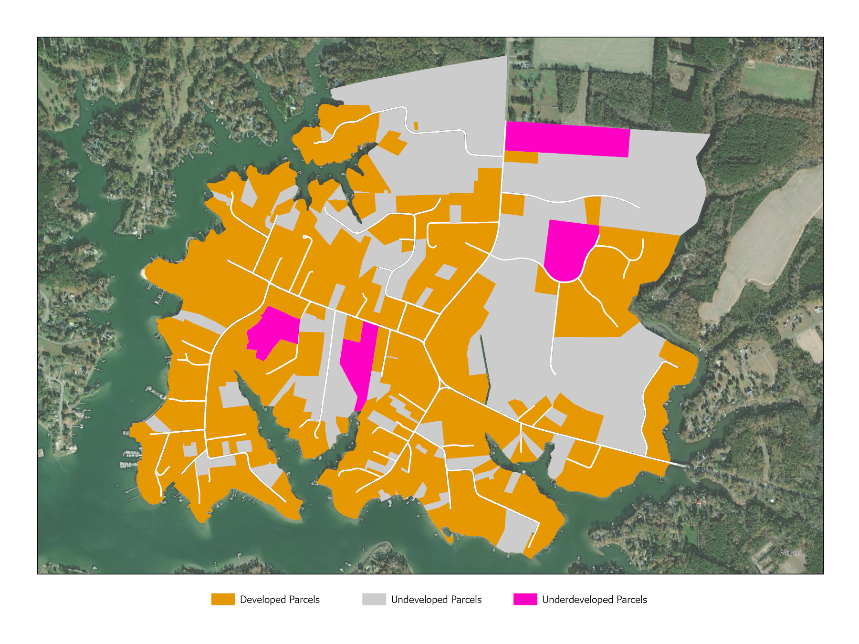
Map of Developed, Undeveloped, & Underdeveloped Land
Note: this is an estimate based on analysis of aerial imagery.

Slide 16
Estimated Developable Land Acreage
Note: this is an estimate based on analysis of aerial imagery.

Slide 17
2022 Community Survey Results Opinions on New Growth (check all that apply)
Note: Percentages of total responses. Respondents could select multiple options

Slide 18
2022 Community Survey Results Opinions on Housing Types (check all that apply)
Note: Percentages of total responses. Respondents could select multiple options
Notes:
Will

Slide 19
Future Residential Development: 2023 Stakeholder Meeting Responses
Support | Conditionally Support | Neutral | Conditionally Oppose | Oppose
4 | 6 | 17 | 0 | 2
Preservation of the Town’s existing character
Acceptance of additional single-family residential development in line with existing zoning that happens without any specific intervention by the Town
Opposition to multifamily housing
A need for more smaller, less expensive single-family housing options for young families and those looking to age in place

Slide 20
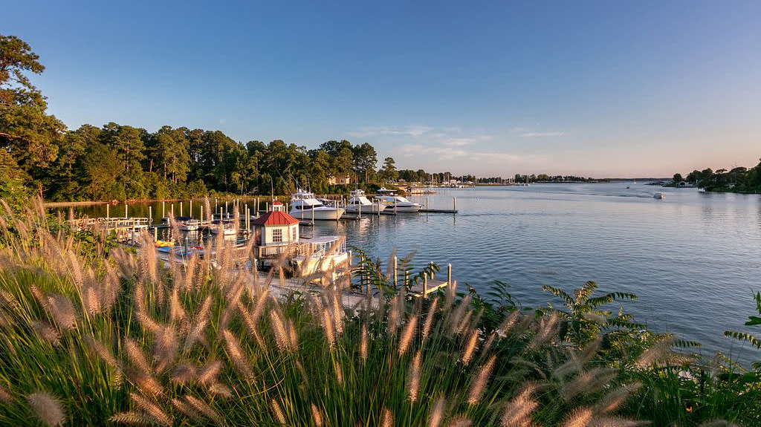
Other Topics

Slide 21
Meals Taxes in the Region
Tappahannock: 6%
Kilmarnock: 5%
Urbanna: 5%
Warsaw: 5%
White Stone: 2.5%
Westmoreland County: 5%
Middlesex County: 4%
Mathews County: 4%
Gloucester County: 4%
Montross: No meals tax
Reedville: No meals tax
Essex County: No county-wide meals tax
Lancaster County: No county-wide meals tax
Richmond County: No county-wide meals tax
Northumberland County: No county-wide meals tax

Slide 22
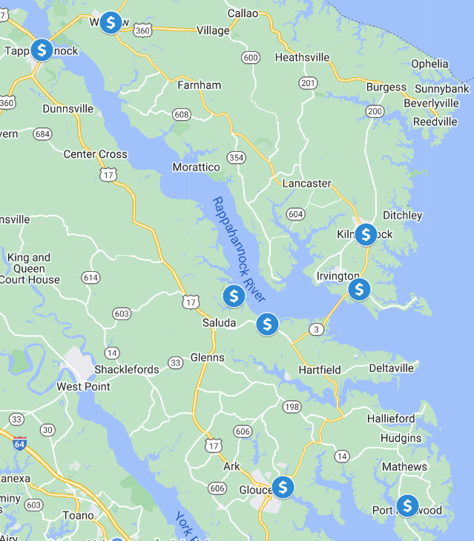
Meals Taxes in the Region

Slide 23
Meals Taxes: 2023 Stakeholder Meeting Responses
Support | Conditionally Support | Neutral | Conditionally Oppose | Oppose
0 | 9 | 8 | 2 | 5
A need for more information and clarity on what the meals tax would be used for before forming a strong opinion either way
Conditional support for a meals tax with a defined purpose and end date
Opposition to any additional taxes and a sense that the Town has enough money
Support for a meals tax around 2.5% that goes directly towards a sewer system

Slide 24
Town Commons Improvements: 2023 Stakeholder Meeting Responses
Support | Conditionally Support | Neutral | Conditionally Oppose | Oppose
7 | 12 | 4 | 1 | 3
General support for minor, inexpensive improvements to landscaping, beautification, etc.
Support for public restrooms, specifically mobile ones that are less costly and easier to install/remove
Support for resurfacing the tennis courts
Support for refurbishing the playgrounds
Satisfaction with things the way they are
Opposition to spending a lot of money on improving the Commons

Slide 25
Sidewalk Improvements: 2023 Stakeholder Meeting Responses
Support | Conditionally Support | Neutral | Conditionally Oppose | Oppose
7 | 14 | 6 | 0 | 0
General support for repairing existing sidewalks
Some support for extending the sidewalk to the other side of Irvington Rd.
Some support for filling in gaps where there is no sidewalk
General opposition to installing sidewalks in West Irvington due to ditches, encroachment on private property
Some support for widening sidewalks where feasible

Slide 26
Traffic Calming: 2023 Stakeholder Meeting Responses
Support | Conditionally Support | Neutral | Conditionally Oppose | Oppose
23 | 1 | 0 | 0 | 0
All participants were in favor of some form of traffic calming in Town
Some participants were in favor of enhanced enforcement, speed traps, a police officer on duty, etc.
Some support for speed bumps, bump-outs
Some support for traffic circles and other efforts that could also enhance beautification
Some support for enhanced golf cart access throughout town as well as improvements to crossings and parking

